Slide 1
Project Plan
Christian M. Adriano
christian.adriano@hpi.de

Slide 2
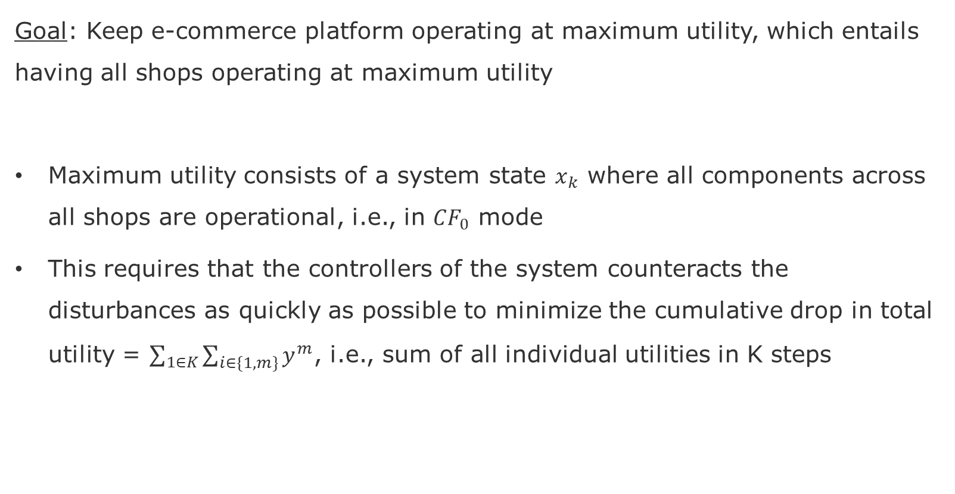
User Goal
Goal: Keep e-commerce platform operating at maximum utility, which entails having all shops operating at maximum utility
Maximum utility consists of a system state $x_{k}$ where all components across all shops are operational, i.e., in $CF_{0}$ mode
This requires that the controllers of the system counteracts the disturbances as quickly as possible to minimize the cumulative drop in total utility = $\sum_{1∈K}{\sum_{i∈\{1,m\}}{y^{m}}}$, i.e., sum of all individual utilities in K steps

Slide 3

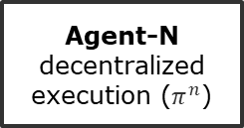
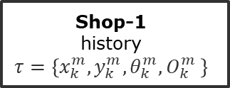
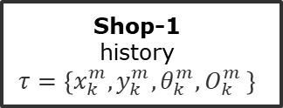


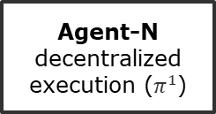

Scenario – Multi-Agent Reinforcement Learning
Trainer
centralized cooperation
Agent-N
decentralized execution ($π_{ }^{1}$)
Agent-N
decentralized execution ($π_{ }^{n}$)
Observation $O^{m}$
Reward $R_{k}$
Action $A^{m}$
Observation $O^{m}$
Reward $R_{k}$
Action $A^{m}$
Shop-1
history
$$τ=\left\{x_{k}^{m},y_{k}^{m}, θ_{k}^{m}, O_{k}^{m} \right\}$$
…
Shop-1
history
$$τ=\left\{x_{k}^{m},y_{k}^{m}, θ_{k}^{m}, O_{k}^{m} \right\}$$
mRubis
failure propagation model (FPM)
failure injection model (FIM)
by Christian M. Adriano

Slide 4
Definitions

Slide 5
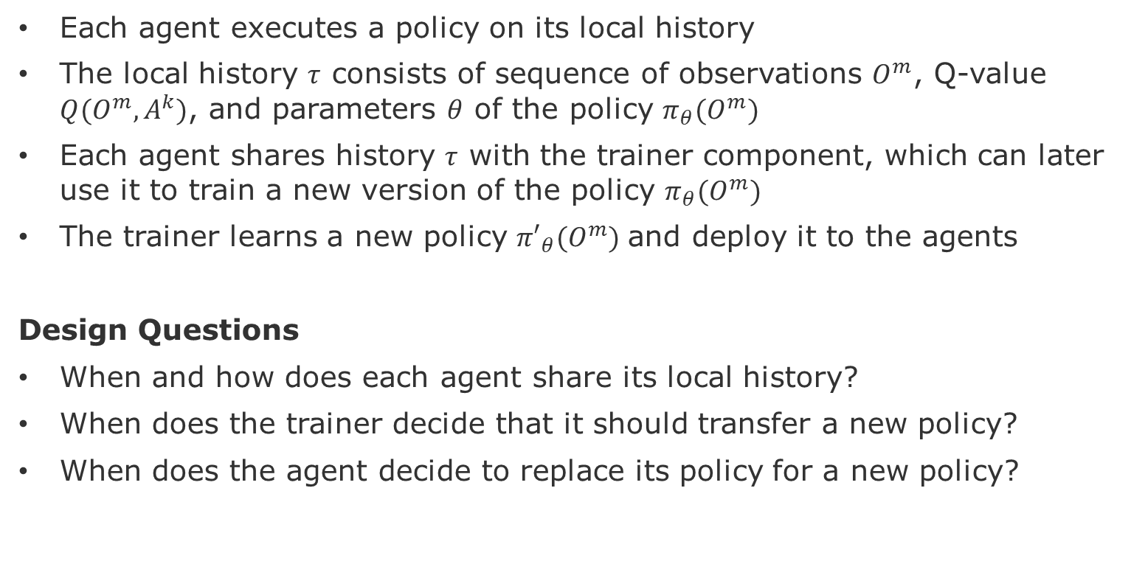
Definition – Agents e Trainer
Each agent executes a policy on its local history
The local history $τ$ consists of sequence of observations $O^{m}$, Q-value $Q(O^{m},A^{k})$, and parameters $θ$ of the policy $π_{θ}(O^{m})$
Each agent shares history $τ$ with the trainer component, which can later use it to train a new version of the policy $π_{θ}(O^{m})$
The trainer learns a new policy ${π′}_{θ}(O^{m})$and deploy it to the agents
Design Questions
When and how does each agent share its local history?
When does the trainer decide that it should transfer a new policy?
When does the agent decide to replace its policy for a new policy?

Slide 6
Definitions – Shops and Components
A shop consists of components (18), which have specific responsibilities and present interdependencies (directed). Components can have multiple instances to support surges in demand.
The utility of a shop consists of the sum of the utility of its components.
The utility of a component is a function of its parameters.
The parameters of a component consist of:
Degree of connectivity (incoming and outgoing connections)
Number of Requests,
Number of Instances,
Level of Importance (inherited from shop).

Slide 7
Assumptions
Shops work in isolation and do not interfere with the operation each other
However, shops managed by the same agent are expected to share the same general behavior (utility models and fix-failure probability)
Failure Observations have a single failure that can be fixed (root-cause).
This means that after fixing the root-cause, all other failure observations cease to exist.
Loss of utility is additive, i.e., it does not depend on the context of other components.
Hence, not interactions between component states.
No side-effects of actions, i.e., the actions are either successful or not.
However, actions have costs, that might be factored in the learning process.

Slide 8
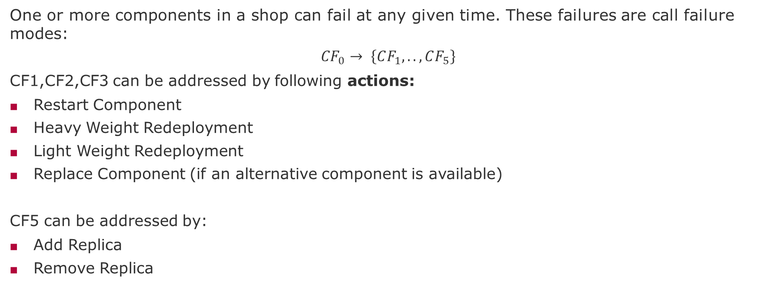
Definition – Failures and Actions
One or more components in a shop can fail at any given time. These failures are call failure modes:
$${CF}_{0}→ \left\{CF_{1},.., CF_{5}\right\}$$
CF1,CF2,CF3 can be addressed by following actions:
Restart Component
Heavy Weight Redeployment
Light Weight Redeployment
Replace Component (if an alternative component is available)
CF5 can be addressed by:
Add Replica
Remove Replica

Slide 9
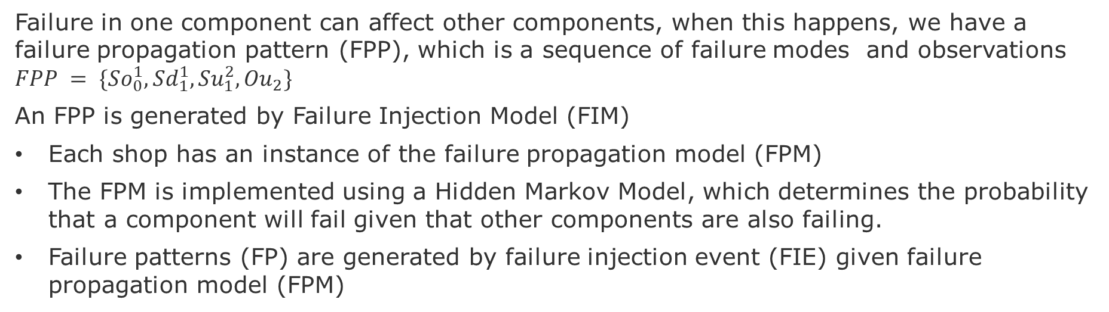
Definition- Failure Propagation Pattern
Failure in one component can affect other components, when this happens, we have a failure propagation pattern (FPP), which is a sequence of failure modes and observations $FPP = \{{So}_{0}^{1},{Sd}_{1}^{1},{Su}_{1}^{2}, {Ou}_{2}\}$
An FPP is generated by Failure Injection Model (FIM)
Each shop has an instance of the failure propagation model (FPM)
The FPM is implemented using a Hidden Markov Model, which determines the probability that a component will fail given that other components are also failing.
Failure patterns (FP) are generated by failure injection event (FIE) given failure propagation model (FPM)
Suggested Tasks:
Review the nomenclature
Map it to mRubis
Understand how FPM, FIE, and FPP are implemented

Slide 10
Project Plan

Slide 11
Levels of Robustness
Level 1 – Robustness to Failure Propagation
Static Confounding (failure masking)
Dynamic Confounding (intermittent failure) or presence of shortcuts (spurious correlations)
Level 2 - Robustness to Under-specification
OOD (Training does not cover the entire distribution space)
Rashamon sets, e.g., Failure Propagation Models are not Unique, Equivalence Classes
Level 3 - Robustness to Distribution Shifts (OUR FOCUS)
Concept drift (Changes in the System Utility – Non-stationarity)
Risk driven training for risk-averse evolution (safety)

Slide 12
Existing Components – Reuse As-Is
Reuse As-Is
1- Failure Propagation Model
Embedding vector of 18 length with binary information about component failure.
2- Failure Injection Mechanism
Generates failure injects that reflect that failure propagation patterns.
3- Reinforcement Learning
Agent is responsible to multiple shops. Agent trains a policy to discover which fix to select given a set of failure observations. Each agent has a policy and regression model to predict utility.

Slide 13
Extend Components – Minimal Modifications
4- Multi-Agent RL:
As-Is: All shops have the same characteristics
To-Be: Shops with distinct characteristics (distinct utility models)
5- Robustness to Perturbations:
As-Is: Experiment showed the lack of robustness and mitigation in a few scenarios related to change in failure propagation (larger sets of failure observations)
To-Be: Automatically detect loss of robustness
5- Transfer Learning:
As-Is: Experiment from one agent to another (full policy transfer)
To-Be: Automatically selects best pairs of agents to transfer policy (ideally partial transfer)

Slide 14
Evaluation (ideas)
1- Cost-Benefit / Value-at-Risk* Trade-offs
Goal: Show different rates of transfer among Agents:
1.1 excessive cost of training (train agents over larger set of failures)
1.2 excessive cost of transfer and redeployment (transfer policies before loss of robustness)
1.3 increase in the risk of loss of robustness (wrong decision under minimal perturbations)
2- Convergence
Goal: Show that different strategies* to learn when to train and redeploy require:
2.1 cumulative regret (AUC) for same total reward (utility)
2.2 sample efficiency to achieve an average value-at-risk
2.3 speed of to converge
*strategies could be different hyper-parameterizations of the algorithms
Look at visualization of RL outcomes - https://araffin.github.io/post/rliable/

Slide 15
End

Slide 16
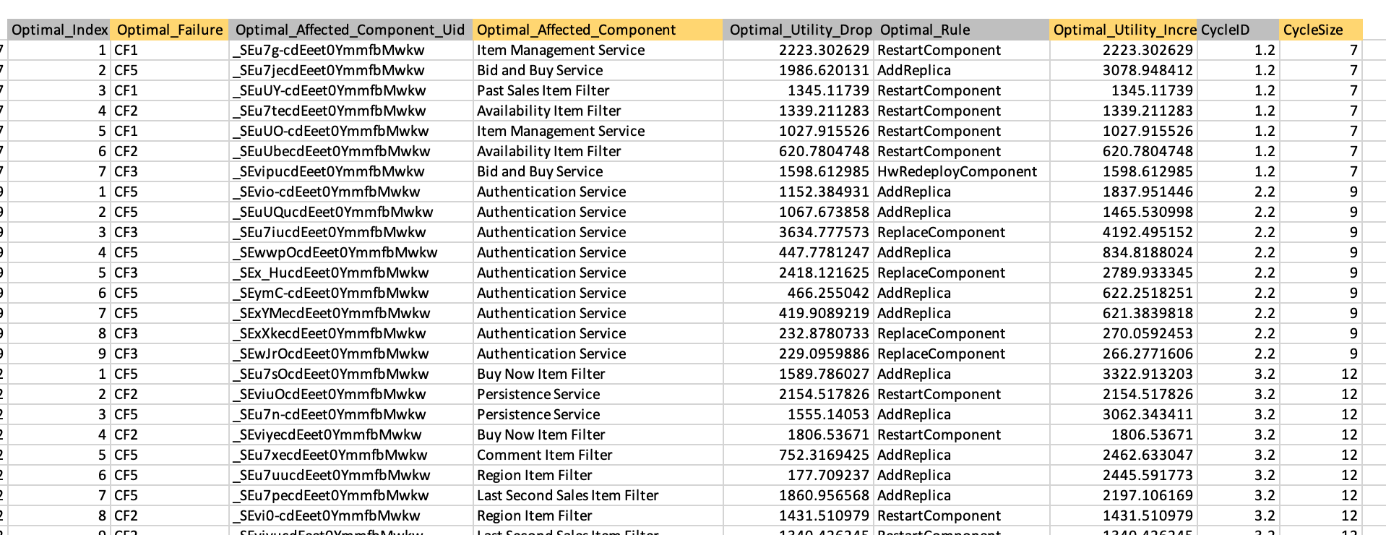
Data Used for the Implementation

Slide 17
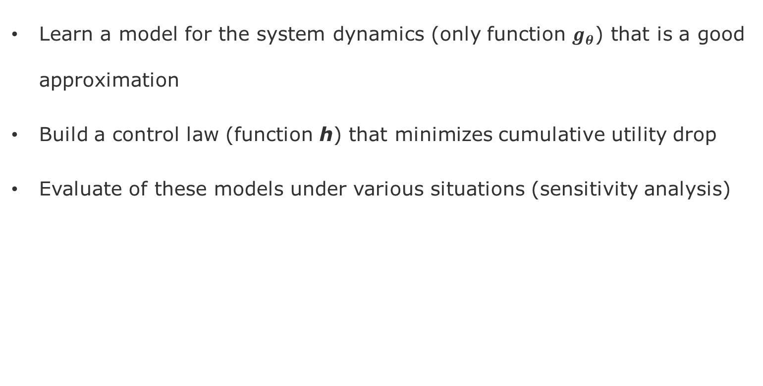
Deliverables
Learn a model for the system dynamics (only function $g_{θ}$) that is a good approximation
Build a control law (function h) that minimizes cumulative utility drop
Evaluate of these models under various situations (sensitivity analysis)

Slide 18
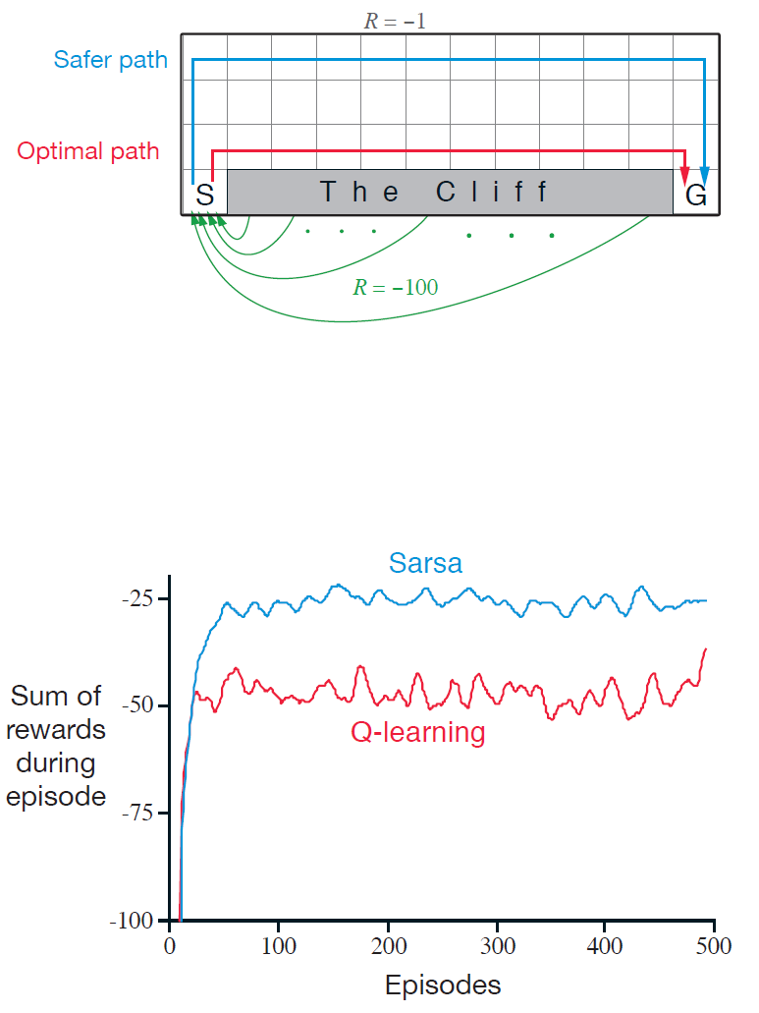
Trade-off between Sarsa and Q-Learning
Gridworld example from [Sutton & Barto 2018] page 132.
Goal: is to go from S to G avoiding the Cliff.

